Slide 1
HR Analytics Attrition

Slide 2
HR ANALYTICS
HR analytics is the process of collecting and analyzing Human Resource (HR) data in order to improve an organization’s workforce performance. The process can also be referred to as talent analytics, people analytics, or even workforce analytics. This method of data analysis takes data that is routinely collected by HR and correlates it to HR and organizational objectives. Doing so provides measured evidence of how HR initiatives are contributing to the organization’s goals and strategies.

Slide 3
OBJECTIVE
Employee attrition is the rate at which employees leave a company. The goal of this analysis is to model employee attrition and determine the most dominant contributing factors that govern this turnover. Through this kind of analysis, we can understand how many employees are likely to leave, while also determining which employees are at the highest risk and for what reasons.

Slide 4
HR Analytics For Attritions Insights

Slide 5
Some Measures
Total Employees: 1,470
Active Employees:1,233
Attrition:237
Attrition Rate:16.12%.
average age of the employees, which is 36.92 years.
the average number of years employees have worked at the company:11.28 years.

Slide 6
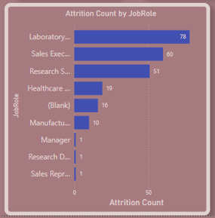
The job roles with the highest attrition are: - Laboratory Technicians: 78 -Sales Executives: 60 - Research Scientists: 51

Slide 7
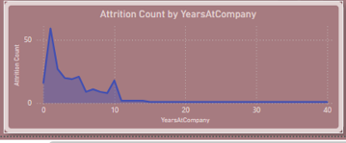
The attrition count is highest among employees who have been with the company for a shorter duration. There is a sharp decline in attrition as tenure increases, suggesting that early career stages are critical for retention efforts

Slide 8
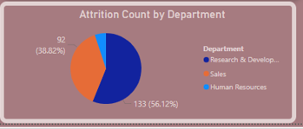
Departments with the highest attrition are: - Research & Development: 133 (56.12%) - Sales: 92 (38.82%) - Targeted interventions in these departments could help reduce turnover and improve overall departmental stability.

Slide 9
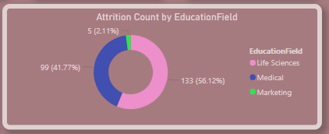
The majority are from Life Sciences (133, 56.12%), followed by Medical (99, 41.77%)

Slide 10
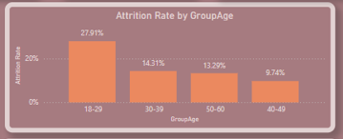
The highest attrition rate is among employees aged 18-29 (27.91%), followed by those aged 30-39 (14.31%).

Slide 11
HR Analytics For Active Employee Insights

Slide 12
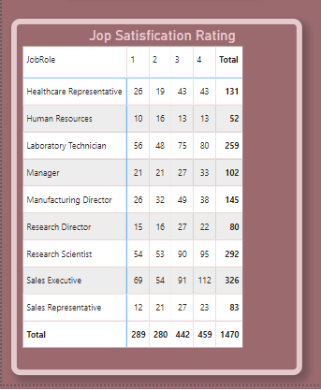
This table displays the job satisfaction rating for different job roles on a scale from 1 to 4. The total count of ratings for each job role is also shown.For example, the "Healthcare Representative" role has a total of 131 ratings distributed across the satisfaction levels

Slide 13
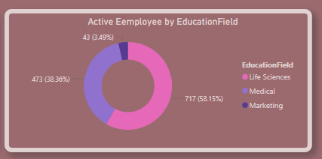
The majority of employees have a background in Life Sciences (58.15%), followed by Medical (38.36%) and Marketing (3.49%)

Slide 14
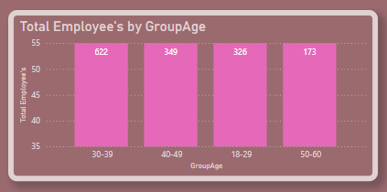
The age groups shown are 30-39, 40-49, 18-29, and 50-60, with the majority of employees in the 30-39 age group (622 employees).

Slide 15
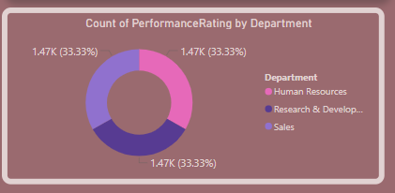
The ratings are evenly distributed among "Human Resources," "Research & Development," and "Sales," each with approximately 33.33% of the total ratings.

Slide 16
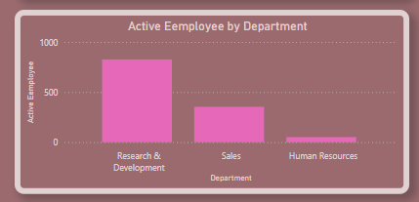
The distribution of active employees across different departments. The "Research & Development" department has the highest number of employees, followed by "Sales" and "Human Resources."

Slide 17
Reccommendation
Implenent retention Strategies for employee around 40 years old
Address attrition in the research & development department
Pay attention to gender disparities in attrition and promot diversity and inclision
Mitigate attrition in the Research & development

Slide 18
Thanks

